Slide 1
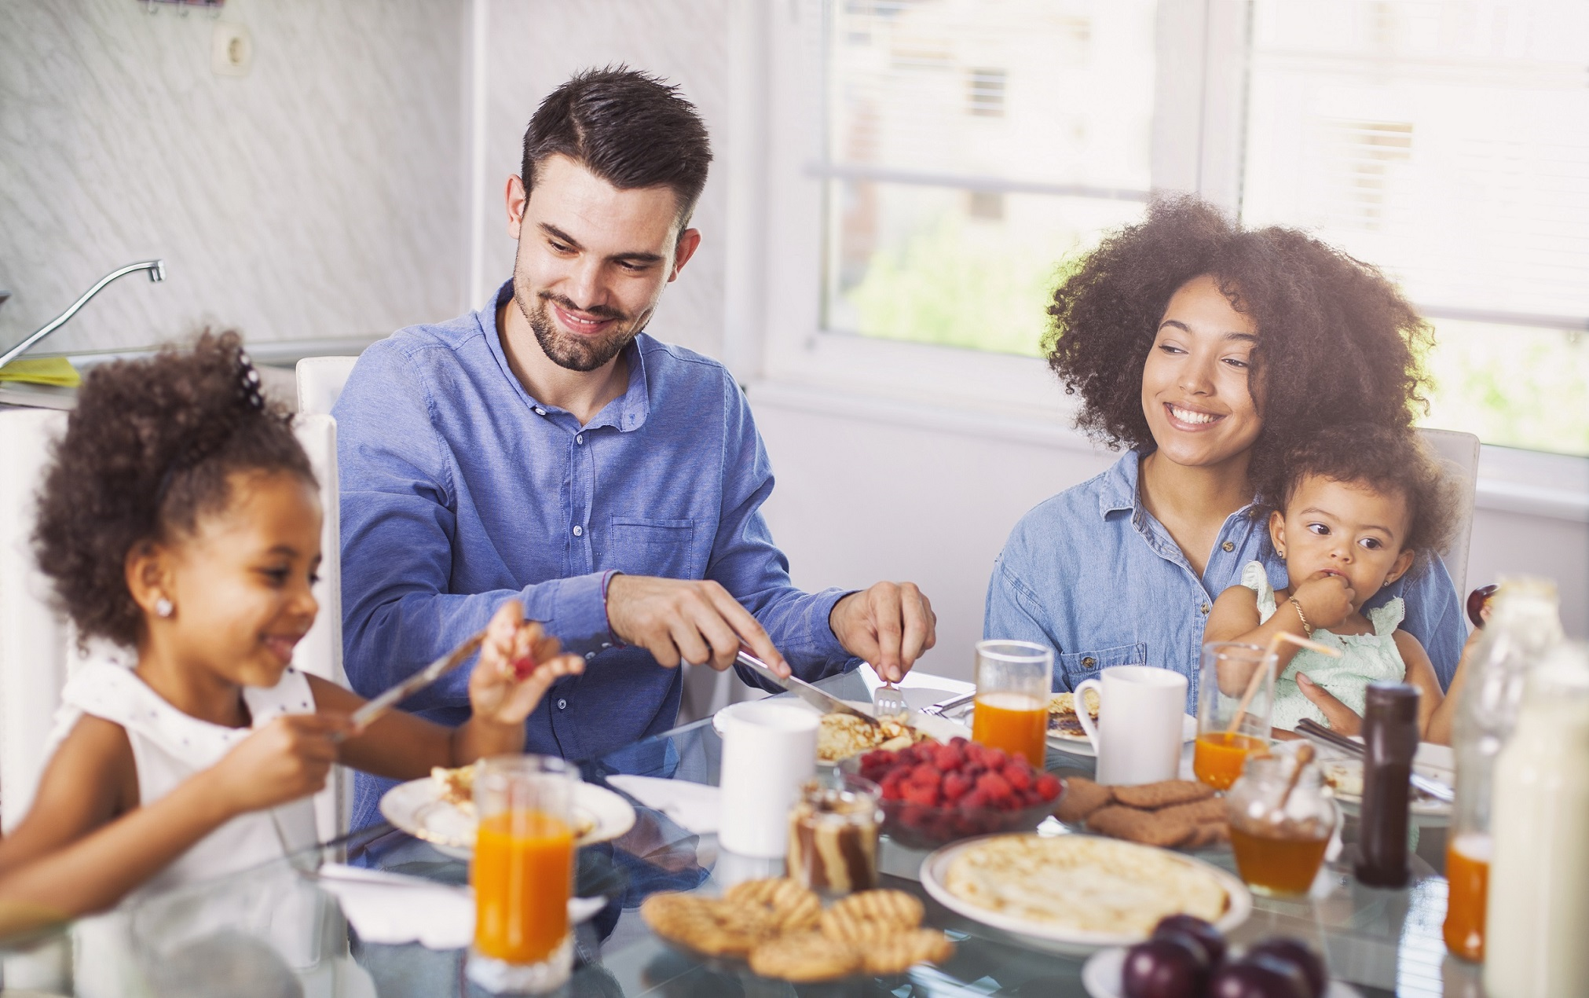

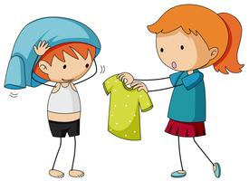


In the morning
www.ardoise-craie.fr

Slide 2


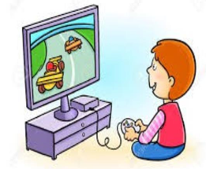

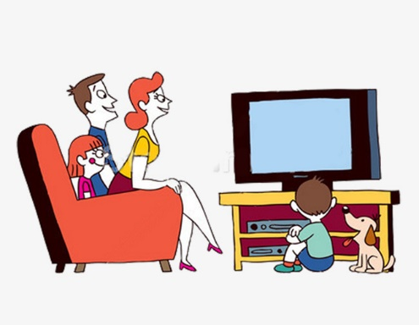
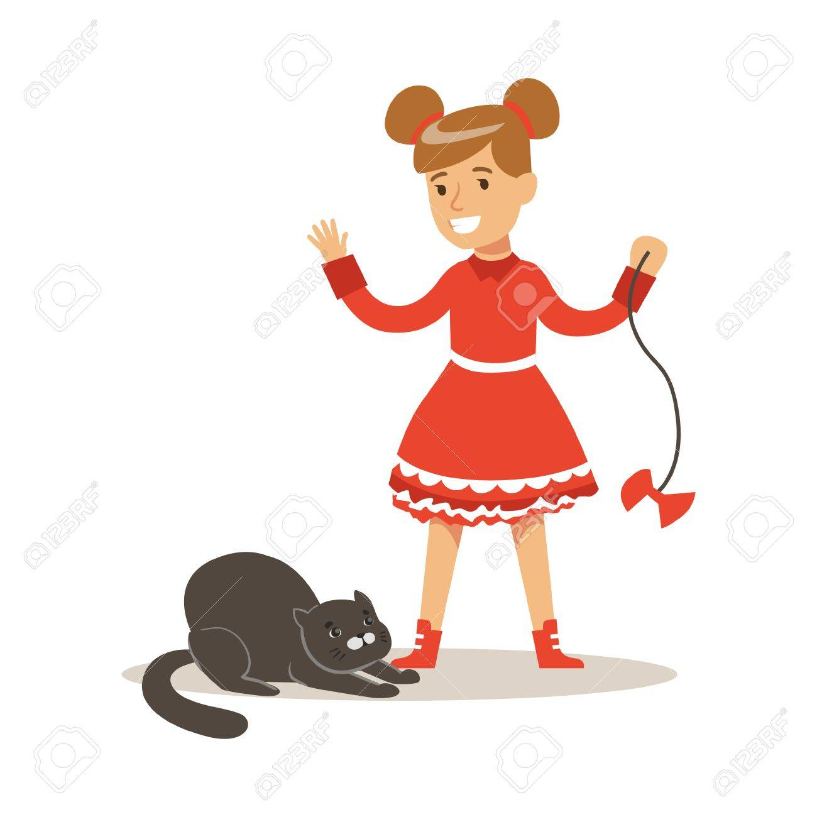

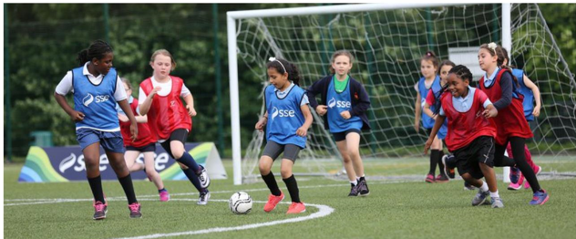
After school
www.ardoise-craie.fr

Slide 3

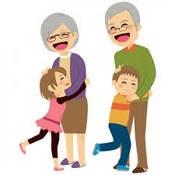
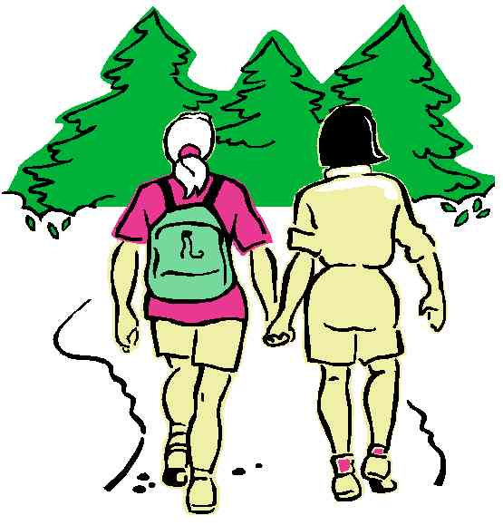
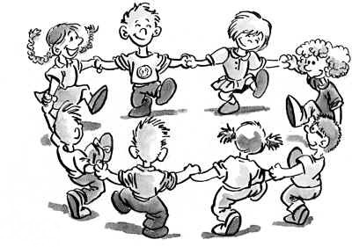

At the weekend
www.ardoise-craie.fr

Slide 4
3
5
2
6
1
4
11
7
8
10
9
14
15
13
12
16
17
www.ardoise-craie.fr

Slide 5
 | Pupil 1 | Pupil 2 | Pupil 3
In the morning
After school
In the weekend
www.ardoise-craie.fr

Slide 6
 | Pupil 4 | Pupil 5 | Pupil 6
In the morning
After school
In the weekend
www.ardoise-craie.fr

Slide 7
 | Pupil 7 | Pupil 8 | Pupil 9
In the morning
After school
In the weekend
www.ardoise-craie.fr

Slide 8
 | Pupil 10 | Pupil 11 | Pupil 12
In the morning
After school
In the weekend
www.ardoise-craie.fr

Slide 9
morning | I | the | up | wake | in
In the morning, I wake up.
have | I | in | breakfast | the | morning
In the morning, I have breakfast.
take | I | in | shower | the | morning | a
In the morning, I take a shower.
dressed | I | the | shower | get | morning | in
In the morning, I get dressed.
morning | I | in | school | the | go | to
In the morning, I go to school.
www.ardoise-craie.fr

Slide 10
after | I | school | do | homework | my
After school, I do my homework.
have | I | after | snack | a | school
After school, I have a snack.
play | I | with | pet | after | school | my
After school, I play with my pet.
phone | I | after | my | friends | school
After school, I phone my friends.
school | I | TV | after | watch
After school, I watch TV.
www.ardoise-craie.fr

Slide 11
at | I | play | friends | weekend | my | with | the
At the weekend, I play with my friends.
go | I | at | walk | the | for | a | weekend
At the weekend, I go for a walk.
surf | at | the | web | I | weekend
At the weekend, I surf the web.
play | I | football | my | friends | at | weekend | the | with
At the weekend, I play football with my friends.
visit | grandparents | at | I | my | weekend | the
At the weekend, I visit my grandparents.
www.ardoise-craie.fr

Slide 12
Write 3 sentences to describe
what you do in your every day life.
 | Pupil 1 | Pupil 2 | Pupil 3
In the morning
After school
In the weekend
www.ardoise-craie.fr

Slide 13
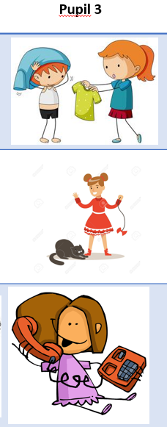
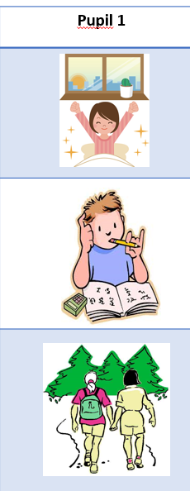

In the morning, I wake up.
After school, I do my homework.
At the weekend, I go for a walk.
In the morning, I have breakfast.
After school, I have a snack.
At the weekend, I play with my friends
In the morning, I get dressed.
After school, I play with my pet.
At the weekend, I phone my friends.
www.ardoise-craie.fr

Slide 14
Write 3 sentences to describe
what you do in your every day life.
 | Pupil 4 | Pupil 5 | Pupil 6
In the morning
After school
In the weekend
www.ardoise-craie.fr

Slide 15
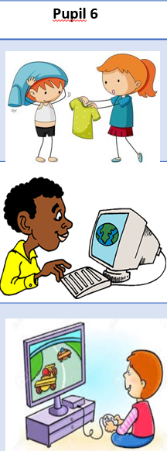
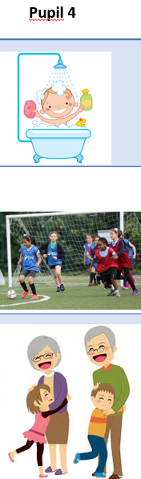

In the morning, I take a shower.
After school, I play football.
At the weekend, I visit my grandparents.
In the morning, I go to school.
After school, I ride a bike.
At the weekend, I watch TV.
In the morning, I get dressed.
After school, I surf the web.
At the weekend, I play videogames.
www.ardoise-craie.fr

Slide 16
Write 3 sentences to describe
what you do in your every day life.
 | Pupil 7 | Pupil 8 | Pupil 9
In the morning
After school
In the weekend
www.ardoise-craie.fr

Slide 17


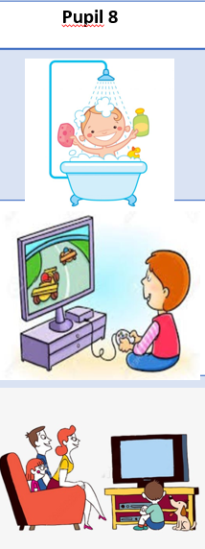
In the morning, I wake up.
After school, I play football.
At the weekend, I ride a bike.
In the morning, I take a shower.
After school, I play videogames.
At the weekend, I watch TV.
In the morning, I get dressed.
After school, I listen to music.
At the weekend, I visit my grandparents.
www.ardoise-craie.fr

Slide 18
Write 3 sentences to describe
what you do in your every day life.
 | Pupil 10 | Pupil 11 | Pupil 12
In the morning
After school
In the weekend
www.ardoise-craie.fr

Slide 19


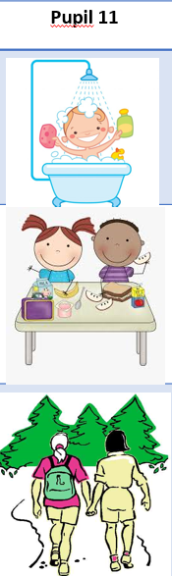
In the morning, I wake up.
After school, I play with my pet.
At the weekend, I play with my friends.
In the morning, I take a shower.
After school, I have a snack.
At the weekend, I go for a walk.
In the morning, I have breakfast.
After school, I do my homework.
At the weekend, I phone my friends.
www.ardoise-craie.fr

