Slide 1
The Story of Valentine’s day
www.ardoise-craie.fr

Slide 2
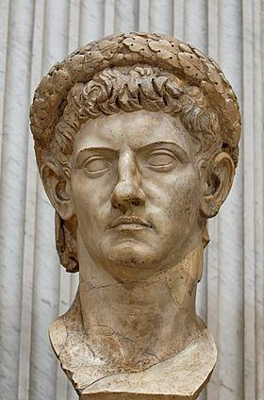
www.ardoise-craie.fr

Slide 3
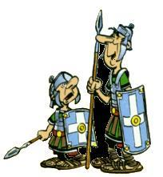
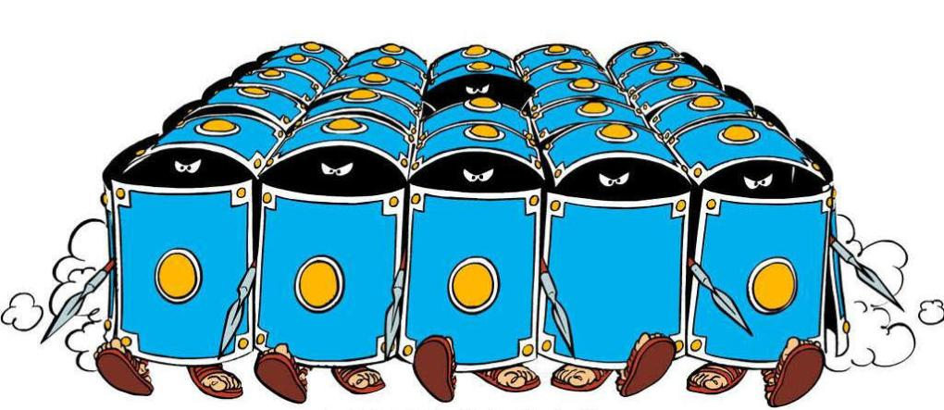

Slide 4
www.ardoise-craie.fr

Slide 5
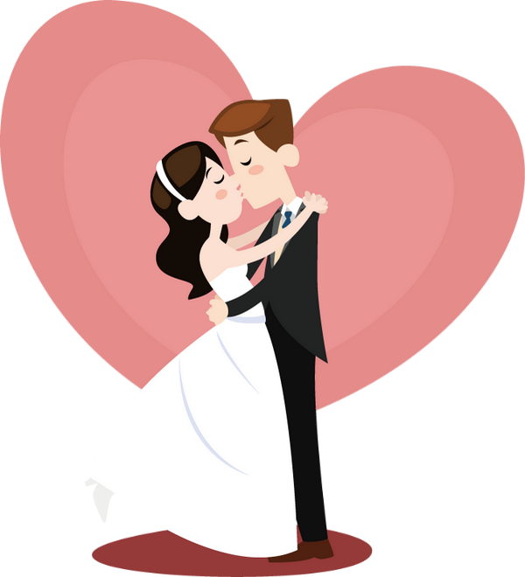
www.ardoise-craie.fr

Slide 6
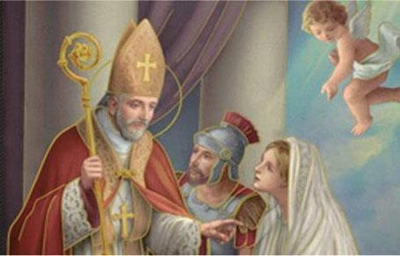
My name is Valentine.
I pronounce you husband and wife
www.ardoise-craie.fr

Slide 7
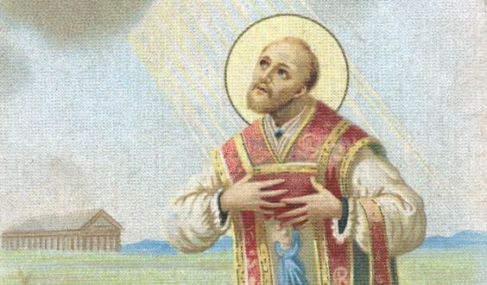
14th February

Slide 8
Vocabulary of Valentine’s day
www.ardoise-craie.fr

Slide 9
a heart
www.ardoise-craie.fr

Slide 10
roses
www.ardoise-craie.fr

Slide 11
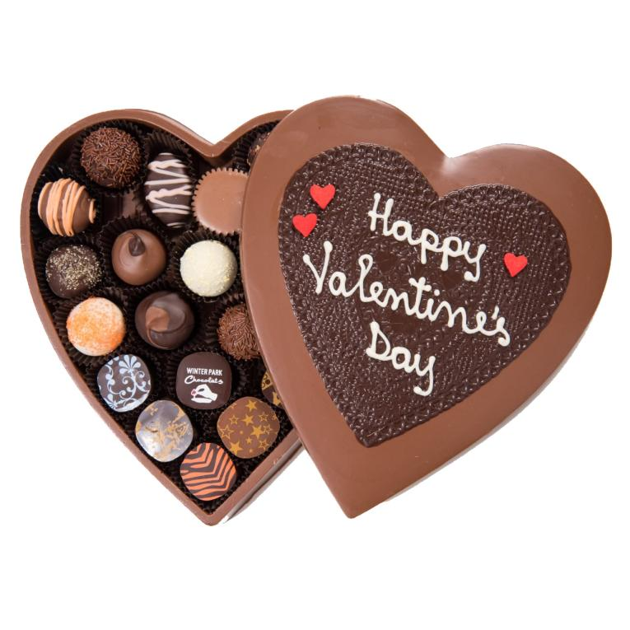
chocolate
www.ardoise-craie.fr

Slide 12
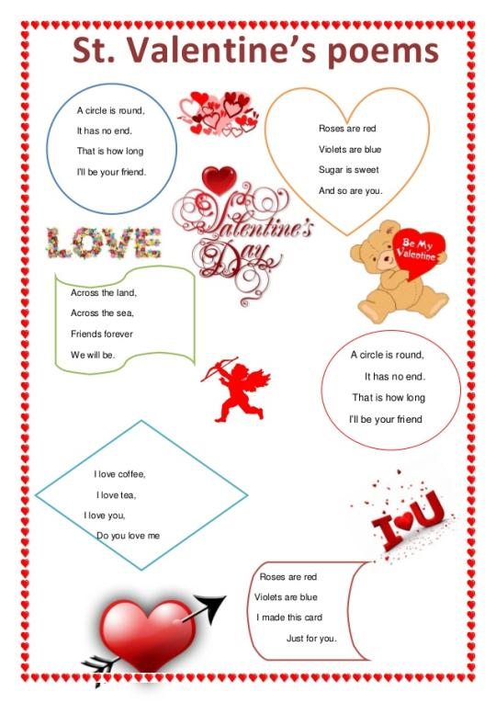
a poem
poems
www.ardoise-craie.fr

Slide 13
a valentine
www.ardoise-craie.fr

Slide 14
Cupid
www.ardoise-craie.fr

Slide 15
a kiss

Slide 16
Valentine’s day is on the fourteenth of February

Slide 17
1
3
2
6
4
5
7
8
www.ardoise-craie.fr

Slide 18
What do people do for Valentine’s day?
www.ardoise-craie.fr

Slide 19
www.ardoise-craie.fr

Slide 20
I love you. You are very intelligent.
I love you because you are very intelligent.
www.ardoise-craie.fr

Slide 21
I don’t like you. You are too intelligent.
I don’t like you because you are too intelligent.

Slide 22
I hate you. You are so funny.
I hate you because you are so funny.
www.ardoise-craie.fr

